Slide 1
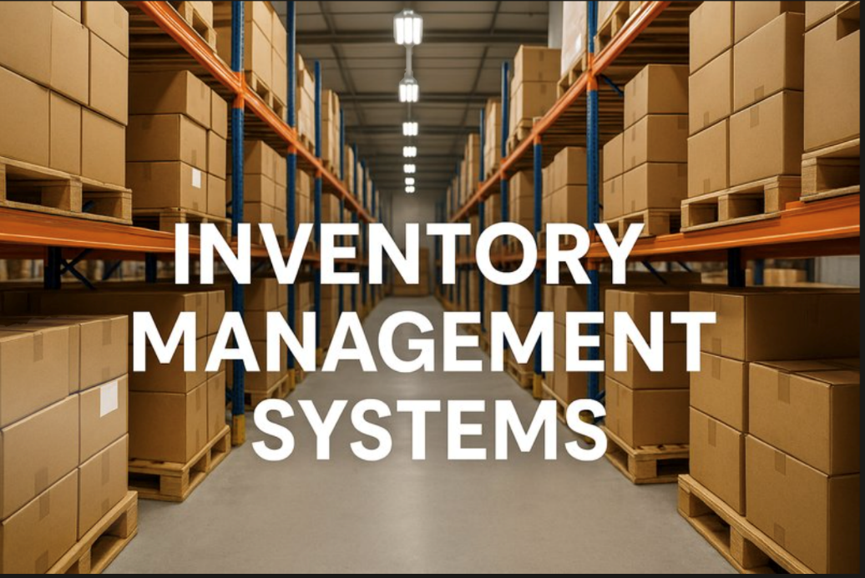
DBMS Cornerstone Project
Inventory Management System
Automated Stock Tracking & Purchase/Sales Management
Kishore Pandiyan SureshKumar· 25B11CS433
Siripurapu Kusuma Kumar· 25B11CS905
L . Siva Ganesh · 25B11CS519
Panashe Ncube· 25B11CSA72

Slide 2
Agenda
Problem statement & requirement analysis
Objectives
Functional & non-functional requirements
End users
ER design — entities, attributes, keys
Relationships & cardinality
Normalization — 1NF, 2NF, 3NF
SQL implementation — DDL, data & queries

Slide 3
Why This Project Is Needed
Justification
Manual inventory systems don’t scale as product quantity increases.
A centralized database reduces duplicate and inconsistent records.
Primary keys and foreign keys maintain relationships between inventory data.
Provides administrators with a queryable view of products, stock, purchases and sales.
Makes inventory transactions easier to track and audit.
Helps identify low-stock products before they run out.

Slide 4
The Real-World Problem
Why manual inventory management breaks down
Stock tracking errors — Manual records can result in incorrect stock quantities and outdated information.
Overstocking & stockouts — Without real-time stock monitoring, products may be over-purchased or become unavailable.
Delayed purchase/sales tracking — Transactions recorded manually make it difficult to know current inventory status.
Supplier information gaps — Supplier details and purchase history may be scattered across different records.

Slide 5
Objectives
Maintain a single record for every product.
Track product quantity and availability.
Manage supplier information.
Record sales transactions.
Identify low-stock products.
Normalize the database to 3NF.
Use SQL queries, joins and aggregates for reporting.

Slide 6
Requirements
Functional
Add, update and search products.
Manage categories and suppliers.
Check product availability.
Generate inventory reports.
Identify low-stock products.
View transaction history.
Non-functional
Data integrity — PK, FK constraints.
Security — Controlled access to inventory data.
Reliability — Accurate transaction processing.
Performance — Fast product and stock searches.
Usability — Simple interface for staff.
Scalability — Supports increasing products and transactions.

Slide 7
Relational Schema
Category (Category_ID, Category_Name, Description)
Supplier (Supplier_ID, Supplier_Name, Contact_NO, Email)
Customer (Customer_ID, Name, Contact_No, Email)
Purchase (Purchase_ID, Supplier_ID(FK), Product_ID(FK), Quantity, Purchase_Date)
Product (Product_ID, Product_Name, Category_ID(FK), Supplier_ID(FK), Price, Stock_Quantity)
Sale (Sale_ID, Customer_ID(FK), Product_ID(FK), Quantity, Sales_Date, Total_Amount)

Slide 8
Relationships & Cardinality
Relationship | Cardinality | Justification
Category — Product | 1:M | One category can contain many products
Supplier — Product | 1:M | One supplier can supply many products
Supplier — Purchase | 1:M | One supplier can have many purchases
Product — Purchase | 1:M | A product can appear in many purchase records
Customer — Sale | 1:M | One customer can make many purchases
Product — Sale | 1:M | A product can appear in many sales

Slide 9
Database Operations
INSERT
Add new products, suppliers and customers.
SELECT
Retrieve available products and stock information.
UPDATE
Update product price or stock quantity.
DELETE
Remove obsolete records.
JOIN
Combine product, supplier and transaction information.
AGGREGATE
Calculate total sales, purchases and stock values.

Slide 10
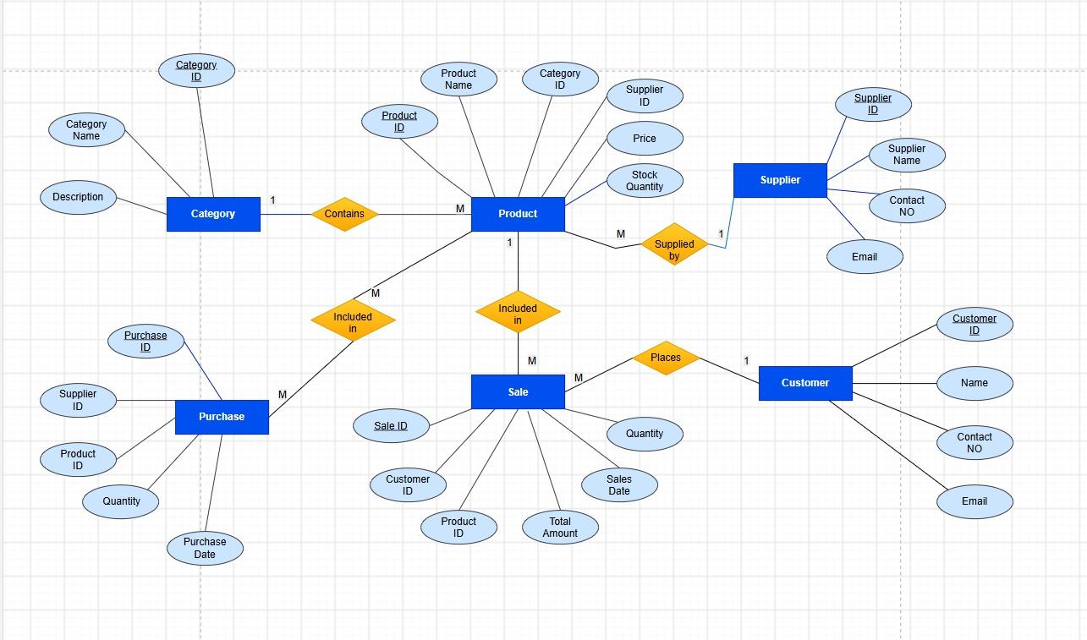
Entity-Relationship Diagram

Slide 11
ORACLE TABLE CREATION
CREATE TABLE Category ( Category_ID NUMBER(5) PRIMARY KEY, Category_Name VARCHAR2(50) NOT NULL UNIQUE, Description VARCHAR2(150) ); CREATE TABLE Customer ( Customer_ID NUMBER(5) PRIMARY KEY, Name VARCHAR2(80) NOT NULL, Contact_No VARCHAR2(15) NOT NULL UNIQUE, Email VARCHAR2(100) NOT NULL UNIQUE ); | CREATE TABLE Supplier ( Supplier_ID NUMBER(5) PRIMARY KEY, Supplier_Name VARCHAR2(80) NOT NULL, Contact_NO VARCHAR2(15) NOT NULL UNIQUE, Email VARCHAR2(100) NOT NULL UNIQUE );

Slide 12
ORACLE TABLE CREATION
CREATE TABLE Product ( Product_ID NUMBER(5) PRIMARY KEY, Product_Name VARCHAR2(100) NOT NULL, Category_ID NUMBER(5) NOT NULL, Supplier_ID NUMBER(5) NOT NULL, Price NUMBER(10,2) NOT NULL CHECK (Price > 0), Stock_Quantity NUMBER(10) NOT NULL CHECK (Stock_Quantity >= 0), CONSTRAINT fk_product_category FOREIGN KEY (Category_ID) REFERENCES Category(Category_ID), CONSTRAINT fk_product_supplier FOREIGN KEY (Supplier_ID) REFERENCES Supplier(Supplier_ID) ); | CREATE TABLE Purchase ( Purchase_ID NUMBER(5) PRIMARY KEY, Supplier_ID NUMBER(5) NOT NULL, Product_ID NUMBER(5) NOT NULL, Quantity NUMBER(10) NOT NULL CHECK (Quantity > 0), Purchase_Date DATE NOT NULL, CONSTRAINT fk_purchase_supplier FOREIGN KEY (Supplier_ID) REFERENCES Supplier(Supplier_ID), CONSTRAINT fk_purchase_product FOREIGN KEY (Product_ID) REFERENCES Product(Product_ID) );

Slide 13
ORACLE TABLE CREATION
CREATE TABLE Sale ( Sale_ID NUMBER(5) PRIMARY KEY, Customer_ID NUMBER(5) NOT NULL, Product_ID NUMBER(5) NOT NULL, Quantity NUMBER(10) NOT NULL CHECK (Quantity > 0), Sales_Date DATE NOT NULL, Total_Amount NUMBER(12,2) NOT NULL CHECK (Total_Amount >= 0), CONSTRAINT fk_sale_customer FOREIGN KEY (Customer_ID) REFERENCES Customer(Customer_ID), CONSTRAINT fk_sale_product FOREIGN KEY (Product_ID) REFERENCES Product(Product_ID) );

Slide 14
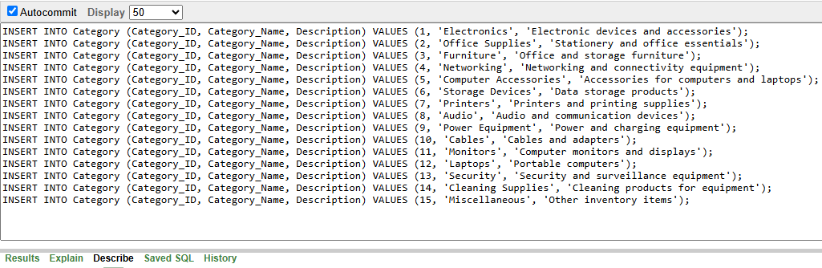
DATA INSERTION IN ORACLE SQL
Category:

Slide 15
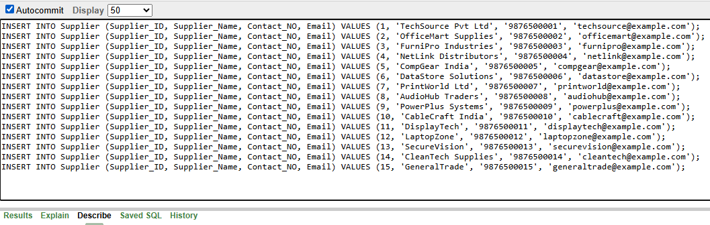
DATA INSERTION IN ORACLE SQL
Supplier:

Slide 16
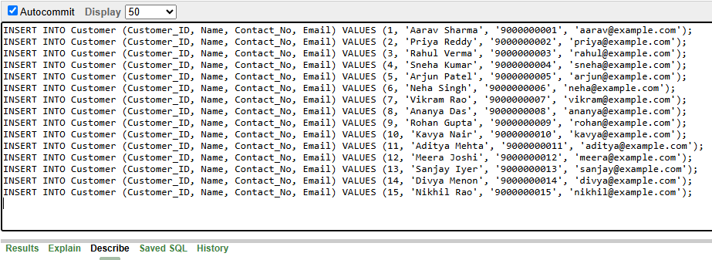
DATA INSERTION IN ORACLE SQL
Customer:

Slide 17
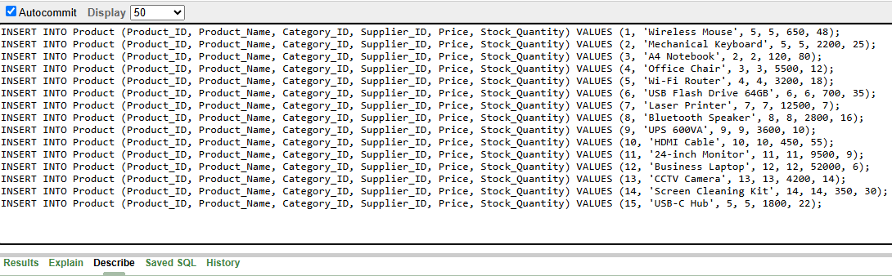
DATA INSERTION IN ORACLE SQL
Product:

Slide 18
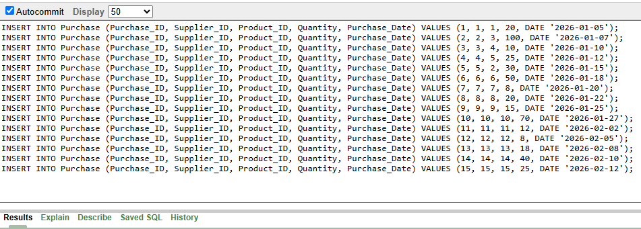
DATA INSERTION IN ORACLE SQL
Purchase:

Slide 19
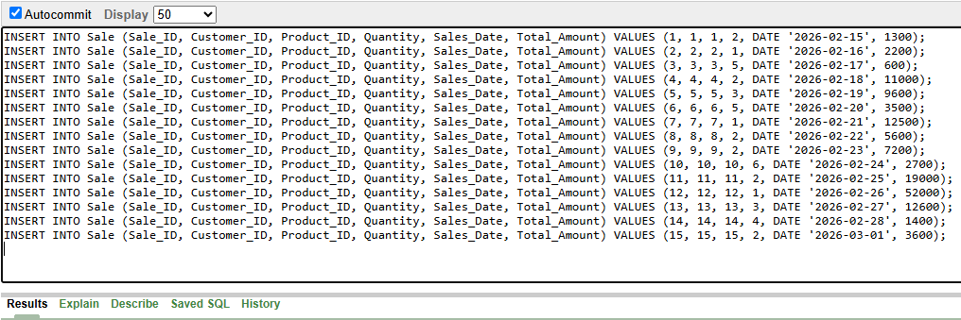
DATA INSERTION IN ORACLE SQL
Sale:

Slide 20
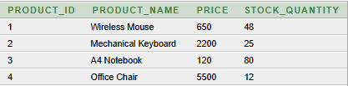
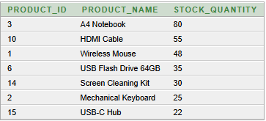
SQL Questions, Queries and Expected Outputs
Basic Query 1
Question: Display all products with their price and current stock quantity.
SQL Query:
SELECT Product_ID, Product_Name, Price, Stock_Quantity
FROM Product
ORDER BY Product_ID;
Basic Query 2
Question: Find products whose stock quantity is greater than 20.
SQL Query:
SELECT Product_ID, Product_Name, Stock_Quantity
FROM Product
WHERE Stock_Quantity > 20
ORDER BY Stock_Quantity DESC;
Expected Output:
Expected Output:

Slide 21
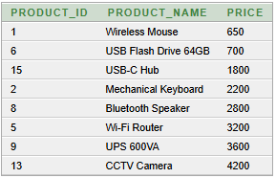
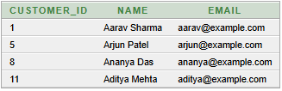
SQL Questions, Queries and Expected Outputs
Basic Query 4
Question: Display customers whose names start with the letter 'A'.
SQL Query:
SELECT Customer_ID, Name, Email
FROM Customer
WHERE Name LIKE 'A%'
ORDER BY Customer_ID;
Expected Output:
Basic Query 3
Question: Find products priced between 500 and 5000.
SQL Query:
SELECT Product_ID, Product_Name, Price
FROM Product
WHERE Price BETWEEN 500 AND 5000
ORDER BY Price;
Expected Output:

Slide 22
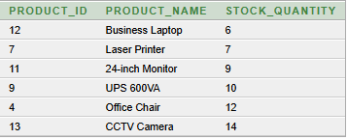
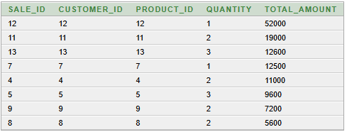
SQL Questions, Queries and Expected Outputs
Basic Query 6
Question: Display sales whose total amount is greater than 5000.
SQL Query:
SELECT Sale_ID, Customer_ID, Product_ID, Quantity, Total_Amount
FROM Sale
WHERE Total_Amount > 5000
ORDER BY Total_Amount DESC;
Expected Output:
Basic Query 5
Question: Find products with stock quantity below 15.
SQL Query:
SELECT Product_ID, Product_Name, Stock_Quantity
FROM Product
WHERE Stock_Quantity < 15
ORDER BY Stock_Quantity;
Expected Output:

Slide 23
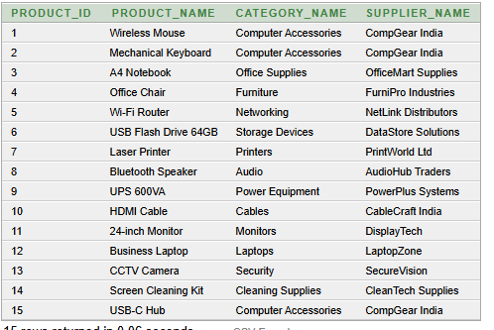
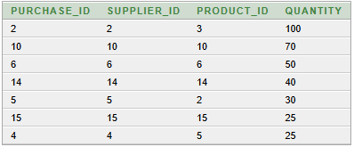
SQL Questions, Queries and Expected Outputs
Advanced Query 1
Question: Display each product with its category name and supplier name using joins.
SQL Query:
SELECT p.Product_ID, p.Product_Name, c.Category_Name, s.Supplier_Name
FROM Product p
JOIN Category c ON p.Category_ID = c.Category_ID
JOIN Supplier s ON p.Supplier_ID = s.Supplier_ID
ORDER BY p.Product_ID;
Expected Output:
Basic Query 7
Question: Find purchase records where the purchased quantity is at least 25.
SQL Query:
SELECT Purchase_ID, Supplier_ID, Product_ID, Quantity
FROM Purchase
WHERE Quantity >= 25
ORDER BY Quantity DESC;
Expected Output:

Slide 24
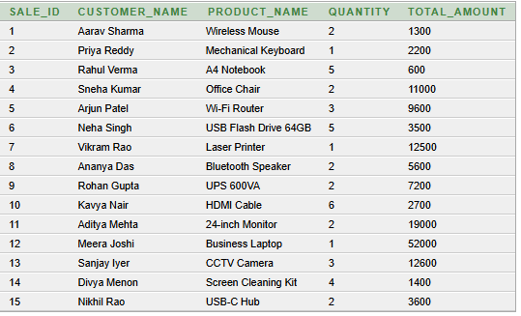
SQL Questions, Queries and Expected Outputs
Advanced Query 2
Question: Display every sale with the customer name, product name, quantity and total amount.
SQL Query:
SELECT sa.Sale_ID, c.Name AS Customer_Name, p.Product_Name,
sa.Quantity, sa.Total_Amount
FROM Sale sa
JOIN Customer c ON sa.Customer_ID = c.Customer_ID
JOIN Product p ON sa.Product_ID = p.Product_ID
ORDER BY sa.Sale_ID;
Expected Output:

Slide 25
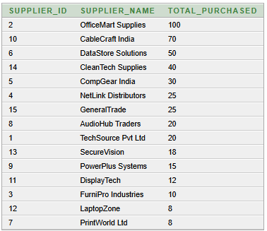
SQL Questions, Queries and Expected Outputs
Advanced Query 3
Question: Calculate the total quantity purchased from each supplier.
SQL Query:
SELECT s.Supplier_ID, s.Supplier_Name, SUM(pu.Quantity) AS Total_Purchased
FROM Supplier s
JOIN Purchase pu ON s.Supplier_ID = pu.Supplier_ID
GROUP BY s.Supplier_ID, s.Supplier_Name
ORDER BY Total_Purchased DESC;
Expected Output:

Slide 26
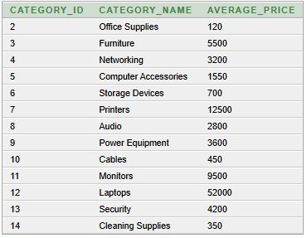
SQL Questions, Queries and Expected Outputs
Advanced Query 4
Question: Calculate the average product price for each category.
SQL Query:
SELECT c.Category_ID, c.Category_Name,
ROUND(AVG(p.Price), 2) AS Average_Price
FROM Category c
JOIN Product p ON c.Category_ID = p.Category_ID
GROUP BY c.Category_ID, c.Category_Name
ORDER BY c.Category_ID;
Expected Output:

Slide 27
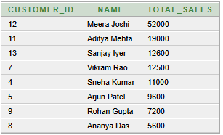
SQL Questions, Queries and Expected Outputs
Advanced Query 5
Question: Find customers whose total sales amount is greater than 5000 using GROUP BY and HAVING.
SQL Query:
SELECT c.Customer_ID, c.Name,
SUM(sa.Total_Amount) AS Total_Sales
FROM Customer c
JOIN Sale sa ON c.Customer_ID = sa.Customer_ID
GROUP BY c.Customer_ID, c.Name
HAVING SUM(sa.Total_Amount) > 5000
ORDER BY Total_Sales DESC;
Expected Output:

Slide 28
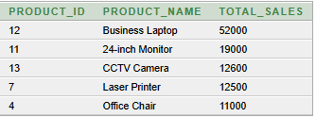
SQL Questions, Queries and Expected Outputs
Expected Output:
Advanced Query 6
Question: Find the five products with the highest total sales amount.
SQL Query:
SELECT *
FROM (
SELECT p.Product_ID,
p.Product_Name,
SUM(sa.Total_Amount) AS Total_Sales
FROM Product p
JOIN Sale sa
ON p.Product_ID = sa.Product_ID
GROUP BY p.Product_ID, p.Product_Name
ORDER BY Total_Sales DESC
)
WHERE ROWNUM <= 5;

Slide 29

SQL Questions, Queries and Expected Outputs
Advanced Query 7
Question: Find products whose price is greater than the overall average product price using a nested subquery.
SQL Query:
SELECT Product_ID, Product_Name, Price
FROM Product
WHERE Price > (SELECT AVG(Price) FROM Product)
ORDER BY Price DESC;
Expected Output:

Slide 30

SQL Questions, Queries and Expected Outputs
Advanced Query 8
Question: Find products whose price is greater than the average price of other products in the same category using a correlated subquery.
SQL Query:
SELECT p.Product_ID, p.Product_Name, p.Price,
(SELECT ROUND(AVG(p2.Price), 2)
FROM Product p2
WHERE p2.Category_ID = p.Category_ID) AS Category_Avg_Price
FROM Product p
WHERE p.Price >
(SELECT AVG(p2.Price)
FROM Product p2
WHERE p2.Category_ID = p.Category_ID)
ORDER BY p.Price DESC;
Expected Output:

Slide 31
Introduction to Normalization
Normalization in DBMS
Normalization is the process of organizing data into well-structured tables to:
Reduce data redundancy
Avoid data inconsistencies
Prevent insertion, update, and deletion anomalies
Improve data integrity
Make database maintenance easier
Why is Normalization Needed?
When related information is stored together unnecessarily, the same data may be repeated many times. This can create problems when inserting, updating, or deleting records.

Slide 32
Introduction to Normalization
Problems Caused by Poor Database Design
1. Insertion Anomaly
Occurs when we cannot insert new information without adding unrelated information.
Example:
A new supplier cannot be recorded unless a product is also entered.
2. Update Anomaly.
Occurs when the same information is stored in multiple rows and must be changed everywhere.
Example:
If a supplier's phone number appears in 10 product records, all 10 records must be updated.
3. Deletion Anomaly
Occurs when deleting one record unintentionally removes other important information.
Example:
If the only product supplied by a supplier is deleted, the supplier's information may also be lost.

Slide 33
Introduction to Normalization
Normalization Process
Normalization Levels
1NF → 2NF → 3NF
1NF
Removes repeating groups
Ensures atomic values
Organizes data into relations
↓
2NF
Removes partial dependencies
Ensures non-key attributes depend on the whole key
↓
3NF
Removes transitive dependencies
Ensures non-key attributes depend only on the primary key

Slide 34
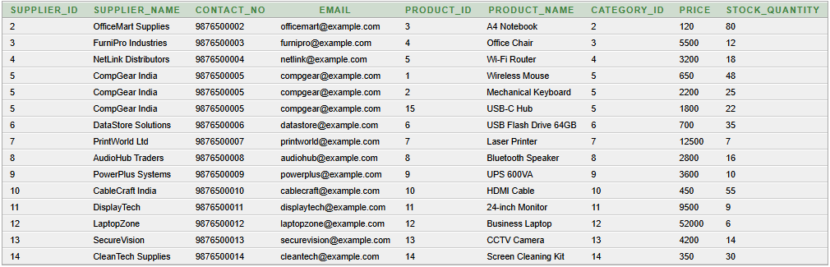
NORMALIZATION
1NF: show atomic values and remove repeating/multi-valued product information.
1NF BEFORE DECOMPOSTION DEMO:UNNORMALIZED RELATION
Problem: Supplier information is repeated whenever the same supplier has multiple products.

Slide 35
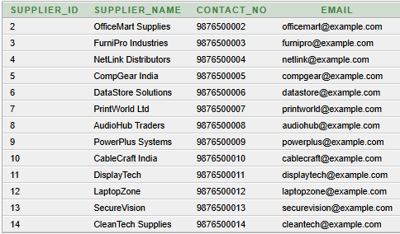
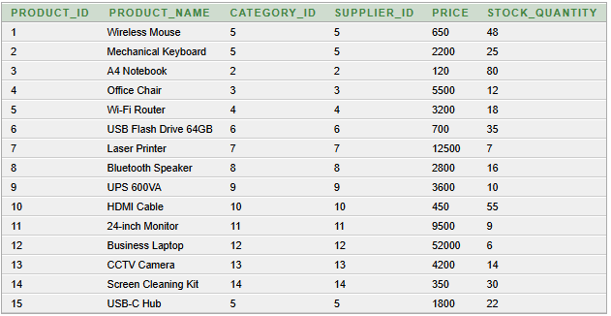
NORMALIZATION
AFTER 1NF DECOMPOSITION:
Supplier:
Product:

Slide 36
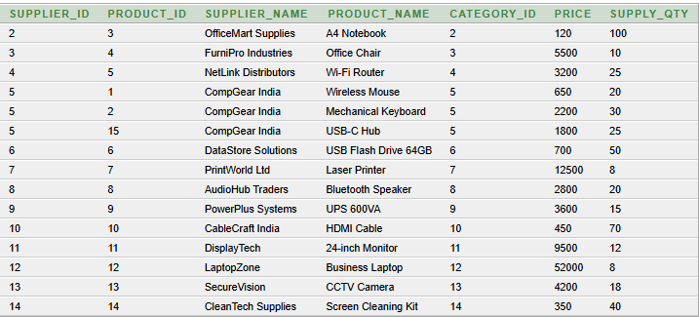
NORMALIZATION
2NF: 1NF + NO PARTIAL DEPENDENCY
2NF BEFORE DECOMPOSITION:
Problem:The primary key is (Supplier_ID, Product_ID)

Slide 37
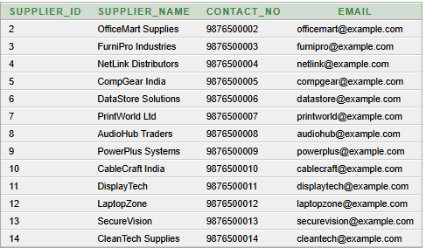
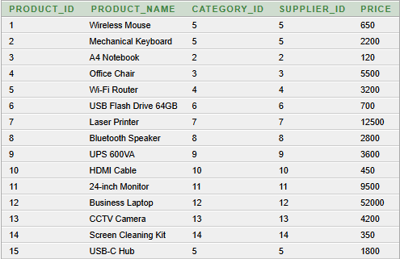
NORMALIZATION
2NF AFTER DECOMPOSITION DEMO:
Supplier_2NF:
Product_2NF:

Slide 38
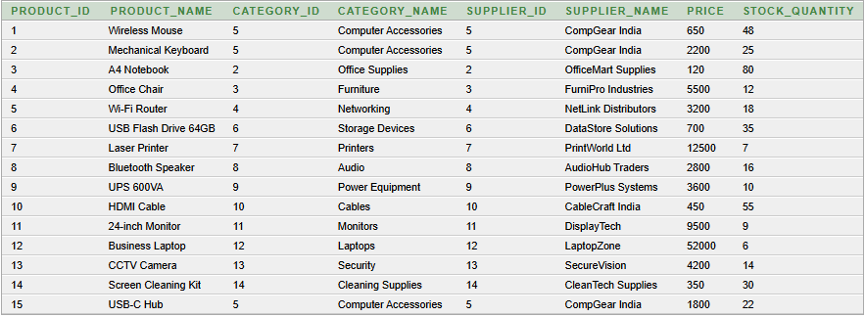
NORMALIZATION
3NF: 2NF + NO TRANSITIVE DEPENDENCY
3NF BEFORE DECOMPOSITION:

Slide 39
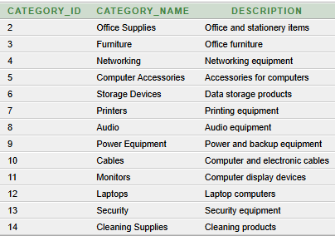
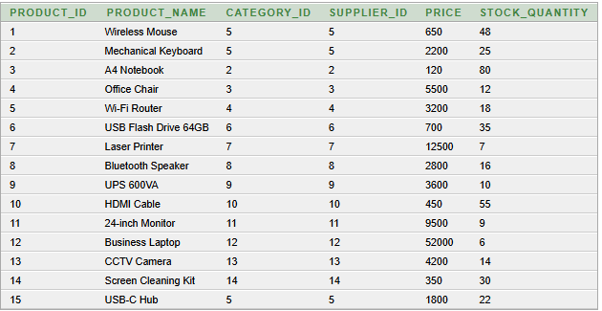
NORMALIZATION
3NF:AFTER DECOMPOSITION:
Category:
Product:

Slide 40
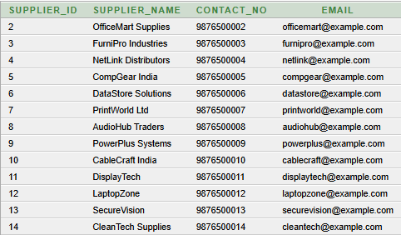
NORMALIZATION
Supplier:

Slide 41
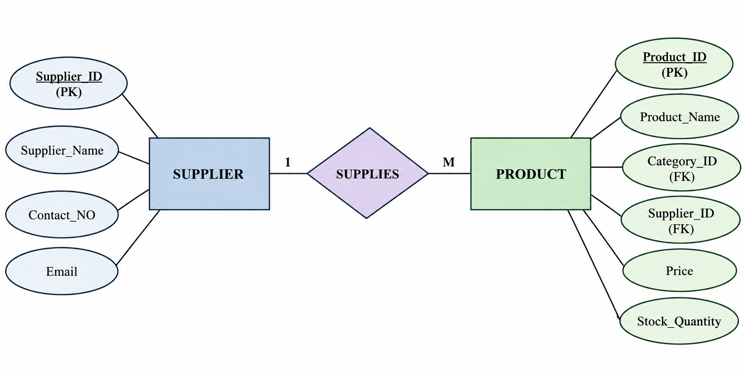
Two Entity ER Diagram
Title: Supplier-Product Relationship:
Relationship: SUPPLIES
Cardinality: 1:M
One supplier can supply many products, while each product is associated with one supplier.

Slide 42
Two Entity ER Diagram
CREATE TABLE Supplier ( Supplier_ID NUMBER(5) PRIMARY KEY, Supplier_Name VARCHAR2(80) NOT NULL, Contact_NO VARCHAR2(15) NOT NULL UNIQUE, Email VARCHAR2(100) NOT NULL UNIQUE ); | CREATE TABLE Product ( Product_ID NUMBER(5) PRIMARY KEY, Product_Name VARCHAR2(100) NOT NULL, Category_ID NUMBER(5) NOT NULL, Supplier_ID NUMBER(5) NOT NULL, Price NUMBER(10,2) NOT NULL, Stock_Quantity NUMBER(10) NOT NULL, FOREIGN KEY (Supplier_ID) REFERENCES Supplier(Supplier_ID) );
SQL Tables from ER Design:

Slide 43
Two Entity ER Diagram
Example: Output
Supplier_ID | Supplier_Name | Product_ID | Product_Name
5 | CompGear India | 1 | Wireless Mouse
5 | CompGear India | 2 | Mechanical Keyboard
5 | CompGear India | 15 | USB-C Hub

Slide 44
Advantages
Reduces manual inventory work.
Prevents duplicate records.
Makes product searching faster.
Tracks sales efficiently.
Improves supplier management.
Provides reliable inventory reports.
Maintains data integrity through DBMS constraints.

Slide 45
Conclusion
The Inventory Management System provides a centralized database for managing products, suppliers, customers and transactions.
DBMS ensures data consistency, integrity and easy retrieval.
SQL queries provide useful inventory reports and analysis.
The system reduces manual effort and improves overall inventory management.
Sales records help maintain accurate transaction records

Slide 46
Thank Youuuuu
Questions welcome

